Slide 1
COVID-19 Time Series Analysis

Slide 2
Introduction
The COVID-19 pandemic, a global health crisis that emerged in late 2019, has significantly impacted countries worldwide. In the United States, the virus has posed formidable challenges, leading to widespread infections and fatalities.
The outbreak in the USA began in early 2020. Descriptive statistics reveal a mean of approximately 47 million confirmed cases and 624,562 deaths, emphasizing the severity and magnitude of the crisis.
This project focuses on developing an accurate time series forecasting model to predict the spread of COVID-19, specifically in the USA.
Notes:
The COVID-19 pandemic was a global health crisis that emerged in late 2019, has impacted countries worldwide.
The outbreak in the USA began in early 2020. Descriptive statistics reveal a mean of approximately 47 million confirmed cases and 624,562 deaths, emphasizing the severity and magnitude of the crisis.
This project focuses on developing an accurate time series forecasting model to predict the spread of COVID-19, specifically in the USA.

Slide 3
Problem Statement
Objective: Develop a robust time series forecasting model.
Importance of accurate predictions for decision-making, resource allocation, and implementing effective public health measures
Notes:
1) Leer
2) The importance of the project is to accurate predict for decision making, resources allocation and implementing effectine public health measures.

Slide 4
Approach - Data Collection
Data source: Johns Hopkins University of Medicine.
Cleaning process: Concatenation of 2 dataset (confirmed cases and death cases), removal of redundant columns.
The dataset extend from January 22, 2020, to March 9, 2023, with no missing values
Statistics confirm absence of outliers.

Slide 5
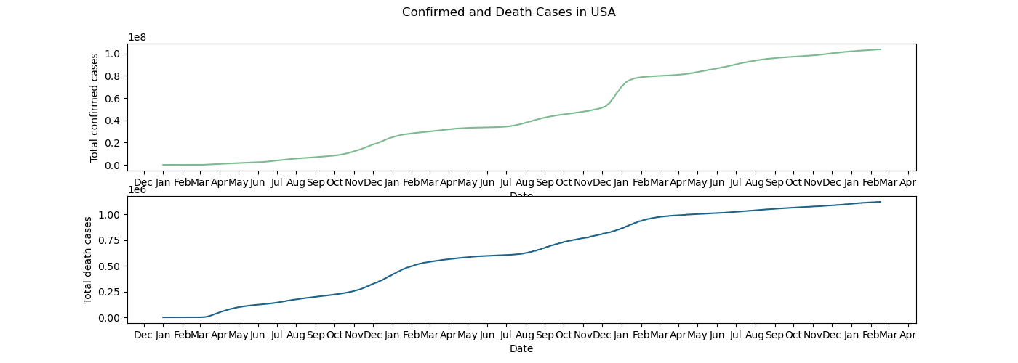
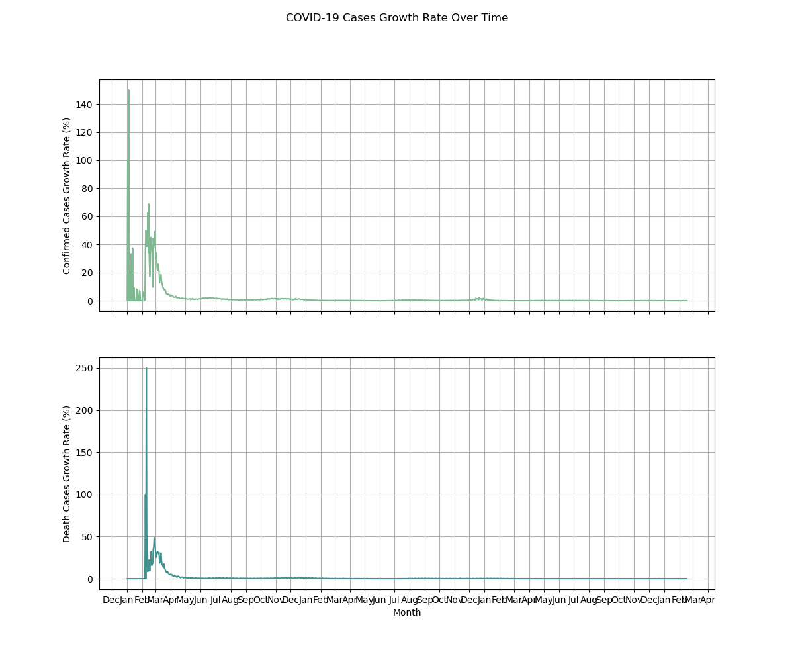
Approach - EDA
Visualization of confirmed and death cases per state and in the USA.
Insights from mortality rate calculation and growth rate analysis.
Notes:
1) In the USA as show in the first graph
2) And the growth rate analysis with the plot as show in the second graph

Slide 6
Feature Engineering and Modeling
Decomposition of positive and death cases data
Data stationarity checks (KPSS and Dickey-Fuller test) and transformation using Log transformation
Hyperparameter tuning for ARIMA model.
Notes:
1) the datasets for both confirmed and death appear to be non-stationary.
2) I did Log transformation to converted into stationary.
3) The hyperparameter tuning for ARIMA model to found the best parameter

Slide 7
ARIMA Model Summary
Confirmed Cases Model
Death Cases Model
ARIMA (1, 1, 1) structure with AR and MA coefficients of 0.9860 and -0.7311, respectively.
Goodness of Fit: Lower AIC, BIC, and HQIC values suggest a better fit.
Residuals Analysis: No significant autocorrelation but departure from normality. Heteroskedasticity present.
ARIMA (1, 1, 1) structure with AR and MA coefficients of 0.9745 and -0.7578, respectively.
Goodness of Fit: Lower AIC, BIC, and HQIC values suggest a good fit.
Residuals Analysis: No significant autocorrelation but departure from normality. Heteroskedasticity present.
Notes:
1) For both model I use a 1,1,1 model.
2)Both models fit the data well based on AIC, BIC, and HQIC values. Residuals show no significant autocorrelation but exhibit departure from normality. Heteroskedasticity is present, indicating variability in residuals.
Look for the mean of departure of normality!!!!!!!!!??????????

Slide 8
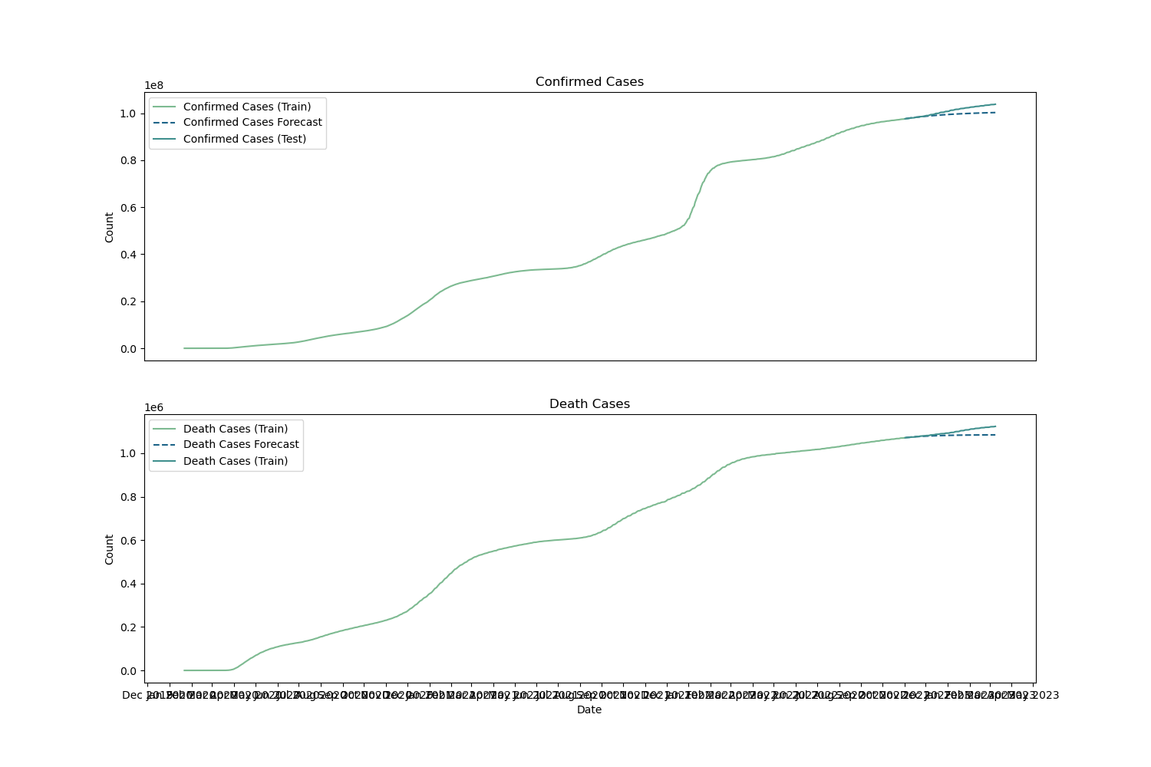
Forecasting
Training data cover 2020-01-22 to 2022-11-01, while the test data covers the subsequent period.
The forecasting period spans from 2022-11-01 to 2023-03-09 covering a total of 5 months.
Notes:
Talk about this with Gonzalo???????????

Slide 9
Ideas for Further Research
Longitudinal Data Analysis
Incorporating External Factors
Ensemble Modeling
Notes:
Longitudinal Data Analysis: Explore the integration of longitudinal data to understand the dynamic nature of COVID-19 progression over time.
Incorporating External Factors: Investigate the inclusion of external factors, such as vaccination rates and public health interventions, to enhance predictive capabilities.
* Ensemble Modeling: Consider the utilization of ensemble models for a more comprehensive understanding of the pandemic's complexity

Slide 10
Conclusion
The initial surge in cases in early 2020 was met with fast responses, leading to a decline in deaths. This highlighted the adaptability of healthcare systems
From April 2020 onward, a sustained positive growth in cases reflected the evolving nature of the virus.
Looking forward, the lesson learned show us the way for continuous monitoring, research, and adaptation. As well as, explore long-term consequences, assess vaccination effectiveness, and contribute to a more resilient global health infrastructure.
The idea behind this project served as a foundational step in the development of predictive models for COVID-19 but also for other diseases. Contributing to data-driven decision-making and public health efforts.
Continuous research and collaboration are imperative to address the evolving challenges posed by the pandemic.
Initially successful, forecasting models showed deviations over time due to evolving virus dynamics. Monthly recurrent training resolved issues, emphasizing the need for dynamic modeling.
Notes:
1) FAST RESPONSES such as the implementation of public health measures, increased testing leading to early detection and isolation, or other interventions.
Decrease in the peaks of positive cases in mid-January suggests the effectiveness of quarantine measures.
2) from April onward, the metrics show a consistent positive growth, leading to a sustained increase in confirmed cases. This period may be influenced by various factors such as evolving variants, changes in testing strategies, or adaptations in public health responses.

Slide 11
Thank you

